Slide 1
Session 03
Classes and Objects
(http://docs.oracle.com/javase/tutorial/java/javaOO/index.html)
Session 03 - Classes and Objects

Slide 2
Objectives
1-Programming Paradigms
2-OOP basic concepts
3-How to identify classes
4-Hints for class design
5-How to declare/use a class
6-Common modifiers (a way to hide some members in a class)
7-Memory Management in Java
8-Garbage Collection
9-Case study: Java program for managing a list of persons
Session 03 - Classes and Objects

Slide 3
Programming Paradigms
High-level programming languages (from 3rd generation languages) are divided into (Wikipedia):
Paradigm | Description
Procedural-oriented (imperative) paradigm-POP (3rd generation language) | Program= data + algorithms. Each algorithm is implemented as a function (group of statements) and data are it’s parameters (C-language)
Object-oriented paradigm (OOP) (3rd generation language) | Programs = actions of some objects. Object = data + behaviors. Each behavior is implemented as a method ( C++, Java, C#,…)
Functional paradigm (4th generation language) | Domain-specific languages. Basic functions were implemented. Programs = a set of functions ( SQL)
Declarative/Logic paradigm (5th generation language) | Program = declarations + inference rules ( Prolog, CLISP, …)
Session 03 - Classes and Objects

Slide 4
Programming Paradigms: POP vs. OOP
Procedure-Oriented Program
Class A
{
}
data1
data1
data2
Function1 ()
Function1 (data1)
Function2 ()
Function2 (data1)
Function3 (data2)
Function4 (data2)
Class B
{
}
Object = Data + Methods
data2
Common methods for accessing a data field:
Function3 ()
Basic Concepts
Encapsulation
Inheritance
Polymorphism
Particular methods:
Constructors
Function4()
Type getField()
void setField (Type newValue)
Session 03 - Classes and Objects

Slide 5
OOP Concepts
  Encapsulation
  Inheritance
  Polymorphism
Session 03 - Classes and Objects

Slide 6
OOP Concepts: Encapsulation
Aggregation of data and behavior.
  Class = Data (fields/properties) + Methods
  Data of a class should be hidden from the outside.
  All behaviors should be accessed only via methods.
  A method should have a boundary condition: Parameters must be checked (use if statement) in order to assure that data of an object are always valid.
  Constructor: A special method it’s code will execute when an object of this class is initialized.
Session 03 - Classes and Objects

Slide 7
OOP Concepts: Inheritance - 1
Ability allows a class having members of an existed class ➔ Re-used code, save time
class PERSON
class STUDENT
ID_Num
Name
YearOfBirth
Address
getID_Num()
setID_Num(newID)
......
ID_Num
Name
YearOfBirth
Address
getID_Num()
setID_Num(newID)
......
inherited
“is a” relationship
extensions
RollNum
Score
getScore()
setSore(newScore)
......
class STUDENT
RollNum
Score
getScore()
setSore(newScore)
......
Son = Father + extensions
Session 03 - Classes and Objects

Slide 8
OOP Concepts: Inheritance - 2
How to detect father class?
Finding the intersection of concerned classes.
Electric Products< code, name, make, price, guaranty, voltage, power>
Ceramic Products < code, name, make, price, type >
Food Products < code, name, make, price , date, expiredDate >
Product
code
name
make
price
ElectricProduct
Food
guaranty
voltage
power
Ceramic
date
expiredDate
type
Session 03 - Classes and Objects

Slide 9
OOP Concepts: Polymorphism
Ability allows many versions of a method based on overloading and overriding methods techniques.
Overloading: A class can have some methods which have the same name but their parameter types are different.
Overriding: A method in father class can be overridden in it’s derived classes (body of a method can be replaced in derived classes).
Session 03 - Classes and Objects

Slide 10
How to Identity a Class
Main noun: Class
Nouns as modifiers of main noun: Fields
Verbs related to main noun: Methods
class Student {
String code;
String name;
int bYear;
String address;
void input() {
<code>
}
void output() {
<code>
}
}
Employee details of a student include code, name, year of birth, address.
Write a Java program that will allow input a student, output his/her.

Slide 11
Hints for class design - 1
Identifying classes: Coupling
  Is an object’s reliance on knowledge of the internals of another entity’s implementation.
  When object A is tightly coupled to object B, a programmer who wants to use or modify A is required to have an inappropriately extensive expertise in how to use B.
Head
High coupling
( Bad design)
Eye1
Eye2
Head
leftEye
rightEye
Eye
Eye
Low coupling
( Good design)

Slide 12
Hints for class design - 2
Implementing methods: Cohesion is the degree to which a class or method resists being broken down into smaller pieces.
class A
M1()
{
}
M2()
{
}
M()
{ M1(); M2();
}
class A
M()
{
}
Operation 1
Operation 1
Operation 2
Operation 2
Low cohesion(bad design)
High cohesion(good design)

Slide 13
Declaring/Using a Java Class
[public] class ClassName [extends FatherClass] {
[modifier] Type field1 [= value];
[modifier] Type field2 [= value];
// constructor
[modifier] ClassName (Type var1,…) {
<code>
}
[modifier] methodName (Type var1,…) {
<code>
}
…….
}
Modifiers will be introduced later.
How many constructors should be implemented? ➔ Number of needed ways to initialize an object.
What should we will write in constructor’s body? ➔ They usually are codes for initializing values to descriptive variables
Session 03 - Classes and Objects

Slide 14
Defining Constructors
Constructors that are invoked to create objects from the class blueprint.
Constructor declarations look like method declarations—except that they use the name of the class and have no return type.
The compiler automatically provides a no-argument, default constructor for any class without constructors.
Session 03 - Classes and Objects
Notes:
This default constructor will call the no-argument constructor of the superclass. In this situation, the compiler will complain if the superclass doesn't have a no-argument constructor so you must verify that it does. If your class has no explicit superclass, then it has an implicit superclass of Object, which does have a no-argument constructor.

Slide 15
Defining Methods
Typical method declaration:
[modifier] ReturnType methodName (params) {
<code>
}
Signature: data help identifying something
Method Signature:
name + order of parameter types
Session 03 - Classes and Objects

Slide 16
Passing Arguments a Constructor/Method
Java uses the mechanism passing by value. Arguments can be:
  Primitive Data Type Arguments
  Reference Data Type Arguments (objects)
Session 03 - Classes and Objects

Slide 17
Creating Objects
Class provides the blueprint for objects; you create an object from a class.
  Point p = new Point(23, 94);
Statement has three parts:
  Declaration: are all variable declarations that associate a variable name with an object type.
  Instantiation: The new keyword is a Java operator that creates the object (memory is allocated).
  Initialization: The new operator is followed by a call to a constructor, which initializes the new object (values are assigned to fields).
Session 03 - Classes and Objects

Slide 18
Type of Constructors
Create/Use an object of a class
Default constructor: Constructor with no parameter.
Parametric constructor: Constructor with at least one parameter.
Create an object
ClassName obj1=new ClassName();
ClassName obj2=new ClassName(params);
Accessing a field of the object
object.field
Calling a method of an object
object.method(params)
Session 03 - Classes and Objects

Slide 19
Notes about Constructors
If we do not implement any constructor, compiler will insert to the class a system default constructor.
If we implement a constructor, compiler does not insert default constructor.
Session 03 - Classes and Objects

Slide 20
Common Modifiers - 1
Modifier (linguistics) is a word which can bring out the meaning of other word (adjective →noun, adverb → verb)
Modifiers (OOP) are keywords that give the compiler information about the nature of code (methods), data, classes.
Java supports some modifiers in which some of them are common and they are called as access modifiers (public, protected, default, private).
Common modifiers will impose level of accessing on
  class (where it can be used?)
  methods (whether they can be called or not)
  fields (whether they may be read/written or not)
Session 03 - Classes and Objects

Slide 21




Common Modifiers - 2
Access level
Applied to
Free-accessing
public
interface
package/ subclass
protected
class
outside cannot access
private
members of
interface/class
package
no specifier
(default)
Interface is a group of prototyped methods and they will be implemented in a class afterward. It will be introduced later.
Order:
public > protected > default > private
Session 03 - Classes and Objects

Slide 22
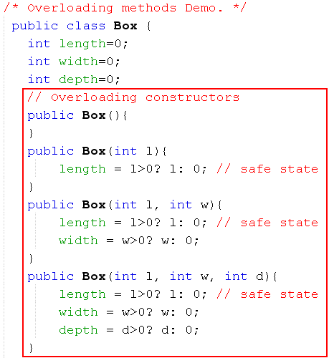
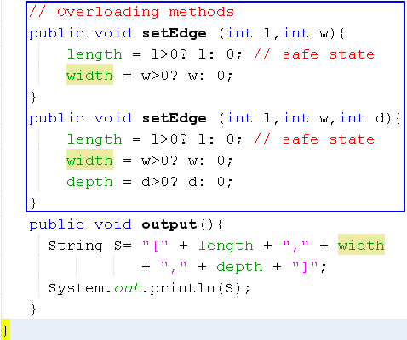
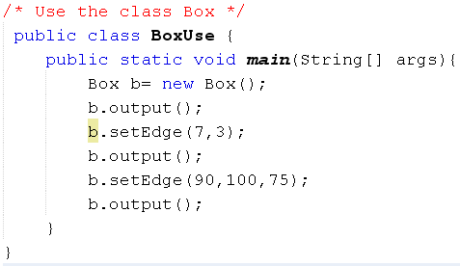

Overloading Method
Session 03 - Classes and Objects

Slide 23
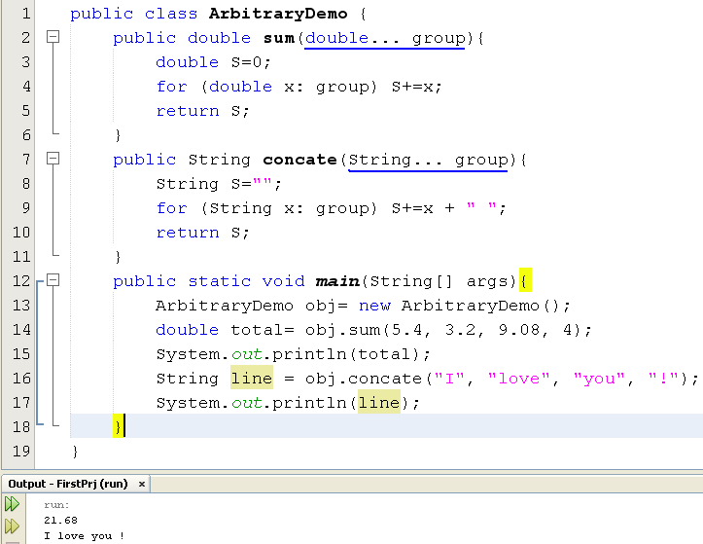
Methods with
Arbitrary Number of Arguments
A group is treated as an array
group.length →number of elements
group[i]: The element at the position i
Session 03 - Classes and Objects

Slide 24
Memory Management in Java - 1
The run-time system of most languages provide two data structures to help manage dynamic memory: the stack and the heap
In Java, the stack is typically used for storing variables of basic data types (such as int, boolean and reference variables) which are local to a method
All objects, which are created from class definitions, are stored on the heap and the language requires garbage collection (GC) for an effective JVM implementation.
Session 03 - Classes and Objects

Slide 25
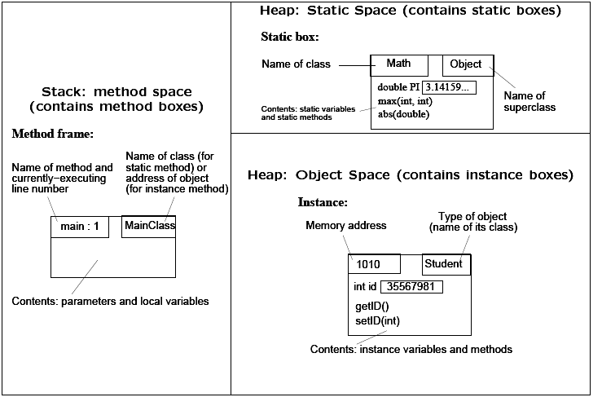
Memory Management in Java - 2
Session 03 - Classes and Objects

Slide 26
Garbage Collection
Most modern languages permit you to allocate data storage during a program run. In Java, this is done directly when you create an object with the new operation and indirectly when you call a method that has local variables or arguments.
Local data of a method include: return data, parameters, variables are declared in the body of the method.
Method locals are allocated space on the stack and are discarded when the method exits, but objects are allocated space on the heap and have a longer lifetime.
Session 03 - Classes and Objects

Slide 27
Garbage Collection…
In Java, you never explicitly free memory that you have allocated; instead, Java provides automatic garbage collection.
The runtime system keeps track of the memory that is allocated and is able to determine whether that memory is still useable.
Garbage collector has the lowest priority. It runs only when the system heap becomes exhausted.
A data is treated as garbage when it is out of it’s scope or an object is assigned to null.
Session 03 - Classes and Objects

Slide 28
Garbage Collection …
Object obj1 = new Object();
int x= 5;
if (x<10) {
Object obj2= new Object();
int y=3;
………
}
int t=7;
obj1 = null;
t*=8;
……
Scope of a variable begins at the line where it is declared and ends at the closing bracket of the block containing it
obj2, y are out of scope ( they are no longer used)
obj1= null → Memory allocated to obj1 is no longer used
Session 03 - Classes and Objects

Slide 29
Garbage Collection…
When does garbage collector execute?
Garbage collector has the lowest priority. So, it runs only when program’s memory is exhausted.
It is called by JVM only. We can not force to activate it (although we can call the System.gc() function, but this does not mean that the garbage collection is activated).
Session 03 - Classes and Objects

Slide 30
Summary
The anatomy of a class, and how to declare fields, methods, and constructors.
Hints for class design:
  Main noun → Class
  Descriptive nouns → Fields
  Methods: Constructors, Getters, Setters, Normal methods
Creating and using objects.
To instantiate an object: Using appropiate constructior
Use the dot operator to access the object's instance variables and methods.
Session 03 - Classes and Objects

